Slide 1

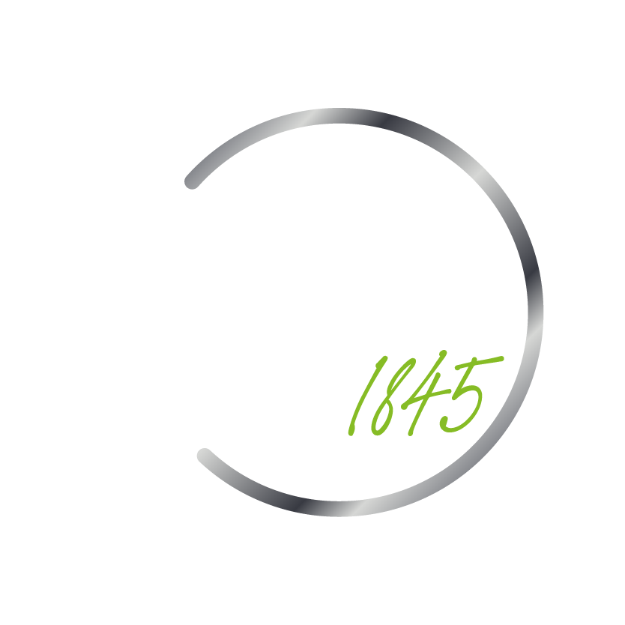
LoyalLock: Predictive Modeling for Customer Segmentation and Churn Reduction

Slide 2




Meet the Team
Nicole Chavarria
Andrew Jarick
Kevin Joan Delgado Perez
Andrea Mercado

Slide 3
Agenda
Topic
Addressing the Challenge
Introducing our Solution
Leveraging Data for Insight
Business Impact
The Process
Delivering Value
Conclusions and Key Takeaways
Q&A
Notes:
Need to update content, person responsible, timing

Slide 4
Introduction
Andrea

Slide 5
Addressing the Challenge
Customer Churn
Predictive Modeling
Impact on Business
- A significant hurdle in the credit card industry.
- High churn rates can negatively affect customer loyalty, brand reputation, and long-term revenue growth.
- Adopting predictive modeling is necessary to refine and enhance our approach to better address the challenge.
Notes:
Customer Churn: A significant hurdle in the credit card industry, leading to substantial revenue loss.
Impact on Business: High churn rates can negatively affect customer loyalty, brand reputation, and long-term revenue growth.
Need for Predictive Tools: In the face of this challenge, predictive modeling emerges as a crucial need to proactively mitigate churn.

Slide 6
Introducing Our Solution: LoyalLock
Predictive Modeling
- Identify and capture which customers at risk of churning.
- Strengthen the industry's market position.
- For understanding overall experience.
Strategic Advantage
- It is Less expensive to retain customers than to acquire new ones.
Notes:
Predictive Modeling: Our predictive modeling doesn't just identify potential customer churn; it can also help us proactively address it. By predicting which customers are likely to churn, we can take preemptive action to engage them and address their concerns before they decide to leave.
Improving Customer Satisfaction: Through this process, we aim to not just retain customers but enhance their satisfaction. By understanding their needs and concerns, we can provide a better customer experience, making them more likely to stay with us and less likely to churn.
Strengthening Market Position: Ultimately, reducing customer churn strengthens your position in the market. Retaining customers is less costly than acquiring new ones and satisfied customers are more likely to recommend us to others, helping us grow.
We believe this solution has the potential to significantly reduce customer churn and its impact on our business. We look forward to your thoughts and feedback as we work towards how we will be implementing this solution.

Slide 7
Exploratory Data Analysis
Andrew

Slide 8
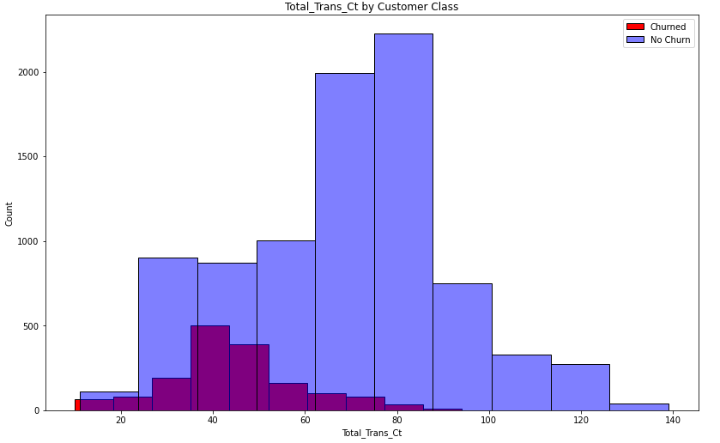
Exploratory Data Analysis
Total transaction count
EDA shows there could be a trend
Mean of churned customers around 45
Mean of customers that stayed around 70

Slide 9
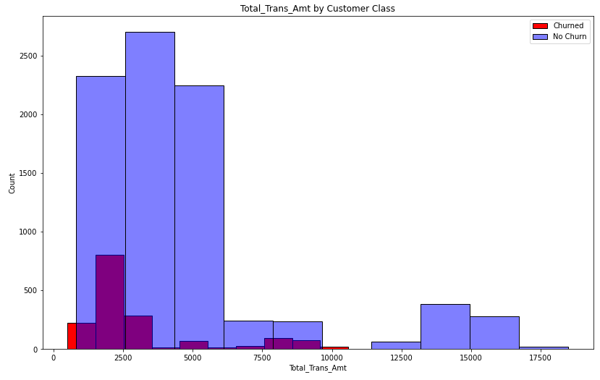
Exploratory Data Analysis
Total transaction amount
EDA shows there could be a trend
Mean of churned customers around 3000
Mean of customers that stayed around 4600

Slide 10

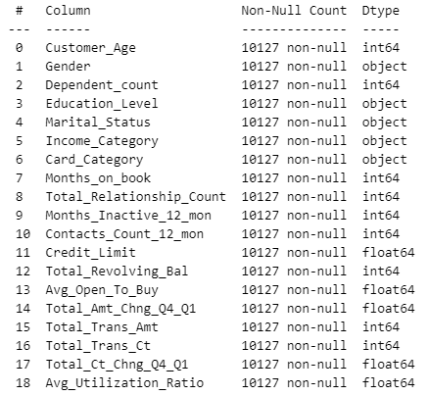
Exploratory Data Analysis
Data Takeaways
Difficult for human to extract meaning from 19 features
Model distinguishes and draws inferences between features
Text vs. Numerical data
More accurate conclusions
Source: Kaggle 2020
Notes:
Although, these two features were very clear in the difference between the loyal and non-loyal customers, there are 18 other features that we must consider as well. Each of which are not very easy for a human to decipher between the two groups. Furthermore, with our eye test, we also cannot draw any conclusions about the interaction between features. This is crucial due to the fact that features are not independent of each other.
Thus, our team created the loyal lock solution in order draw the connections that our human brains cannot. The model will be able to take in all of the 20 features for a given individual and determine whether they are going to leave in the future or not based on the multitude of inferences

Slide 11
Evaluation Metrics
Nicole

Slide 12


The Impact on Business
Precision
Recall
- Focuses on the correctness of positive predictions.
- High precision = fewer false positives
- Capturing all relevant instances
Notes:
Notes:
Precision, Accuracy, and Confusion Matrix are all essential when evaluating the impact that classification models have on the business.
Precision:
Precision plays a vital role when impacting business with the results from predictive modeling. Precision tells you how many positive predictions are made by the model which are correct
Recall: Our model ultimately predicts if a customer is at risk for churning and so brings with it some considerations. The model has the potential to misclassify those who will and won’t churn as the opposite of what they are to be. For this reason we prioritize the measurements of accuracy and, specifically, recall as it emphasizes the models capacity to correctly predict, specifically, accounts which are at risk of churning, decreasing the importance of classifying those who don’t churn, correctly. The subsequent result of which would be offering them financial products that they don’t have a strong need for

Slide 13
Modeling Techniques
Kevin

Slide 14
The Modeling Process
Logistic regression (baseline model)
Decision tree
Random forest
K-Nearest Neighbor
Precision – 94%
Accuracy – 83%
Notes:
Placeholder
Predictive Modeling: LoyalLock doesn't just identify potential customer churn; it can also helps to understand how to proactively address it. By predicting which customers are likely to churn, we can take that preemptive action to engage them and address their concerns before they decide to leave. ( Go into our models )
It was made 4 models to compare the prediction results of customer churn, the baseline model which was a Logistic regression, helps to determine a base result where the other models can improve that prediction, this models was sorted by their complexity, talking about configurations and maths used. The best performance was from Decision tree which have 94% of precision and 83% of accuracy.
Feedback:
Add the precision vs accuracy to reminder to the audience, say about why we choose that model without a technical side.
Do not just read the slides, make a combination of both situations.

Slide 15
Delivering Value
Nicole

Slide 16




Delivering Value
Reduced Customer Churn
Informed Decision Making
Sustainable Revenue Growth
Competitive Advantage
- Decrease customer churn
- Increased customer loyalty
- Customer retention
- Operational improvements
- Financial stability
- Long-term profitability
- Address churn
- Outperform in customer retention
Notes:
Our Solution (LoyalLock) offers:
Reduced Customer Churn: Our predictive modeling offers the potential to significantly decrease customer churn, leading to increased customer loyalty. Through this process, we aim to not just retain customers but enhance their satisfaction. By understanding their needs and concerns, we can provide a better customer experience, making them more likely to stay with us and less likely to churn.
Informed Decision Making: Our insights can aid in the formulation of more effective customer retention strategies and operational improvements.
Sustainable Revenue Growth: By improving customer retention, we're enhancing the company's financial stability and long-term profitability.
Competitive Advantage: With our predictive analytics, the company can proactively address churn and outperform competitors in customer retention.

Slide 17
Moving Forward
Andrew

Slide 18
Conclusions and Takeaways
Data Driven Decisions
Business Impact
Justification for your decisions
Confidence behind your choices
Develop retention strategies
Reduce customer churn
Keep revenue within your company
Prevents revenue going to competitor
Notes:
Placeholder
Wraping up what we have presented (Summary)
Strategic Value: LoyalLock offers a solution to gain insight on the critical challenge of customer churn in your business.
Data-Driven Decisions: Our approach illustrates the power of leveraging customer data to inform and shape effective retention strategies.
Partnership Opportunity: We look forward to our continued collaboration, working closely with you to refine our model and deliver meaningful results.
(AGaBusiness Impact: By proactively addressing churn, we aim to enhance your financial stability and foster long-term growth.

Slide 19
Question & Answers
Thank you for your time. We're now open for any questions you may have.

